Slide 1
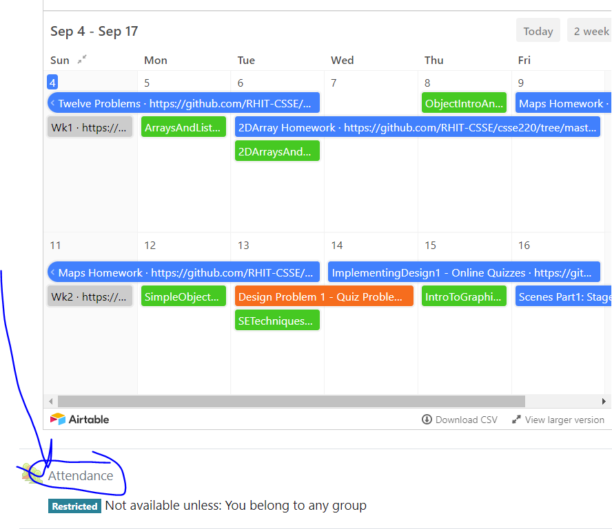
CSSE 220
Today’s Attendance password
__________
Primitive Types: Part1-JavaPrimitiveTypes.pptx
Arrays: Part2-JavaBuiltInArrays.pptx
ArrayLists: Part3-JavaArrayLists.pptx
The git projects for today are:
PracticeArrayList
PracticeArrayListSolution
The Quiz for today is
ArraysAndListsQuiz
Notes:
Aim to have them working on arrays in the 1st hour and arraylists in the second hour

Slide 2
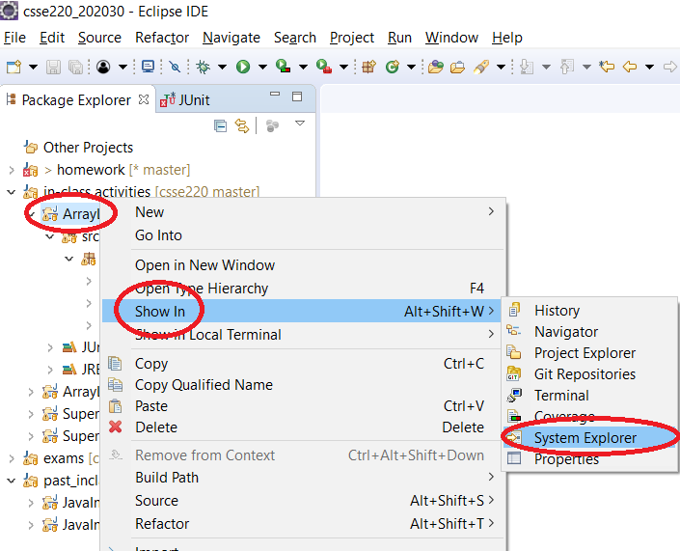
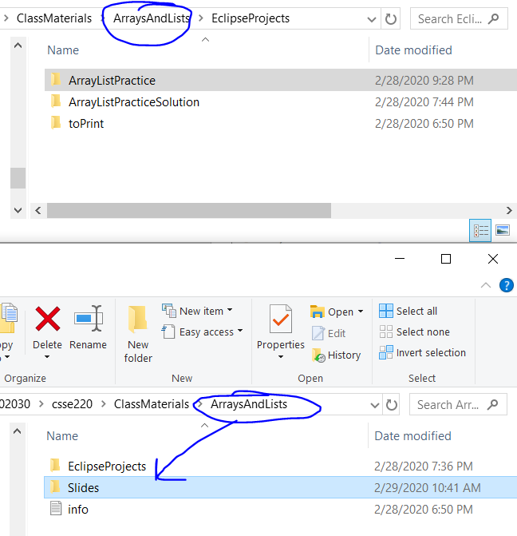
How to access slides (from Eclipse)

Slide 3
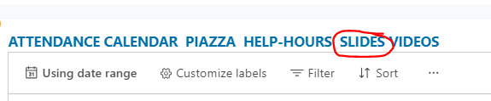
How to access slides (from Internet)

Slide 4
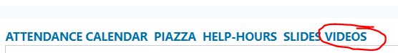
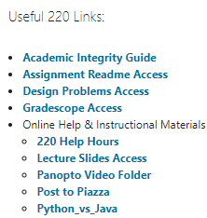
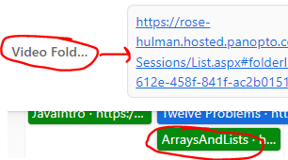
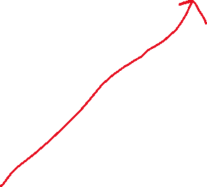
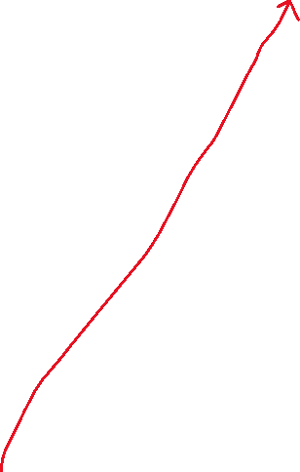


Speed With Which Things Move
Moving up a level in speed
Anticipate as time allows:
Go through slides before class
Familiarize yourself with terminology
Write down questions for instructor
Ask questions in class, or hand piece of paper with questions to instructor at beginning of class
Read the Big Java chapters
Watch pre-recorded videos

Slide 5
Getting things done
If something has a hard deadline, then set a reminder in your smart device
Live by: “if I don’t do it now, it won’t get done”
Speaking of which… HW1…
Notes:
Go over solution from HW1 to make sure students get the answer
intentionally introduce error in HW1 as you go. order of operations. different approaches.

Slide 6
JavaIntro, HW1, TwelveProblems
Any questions: feel free to ask individually
JavaIntro will not be collected and graded
Intended to help you learn
Not intended as busy work
TwelveProblems
Due date on schedule page
First half you can probably do already

Slide 7
Syllabus Highlights

Slide 8
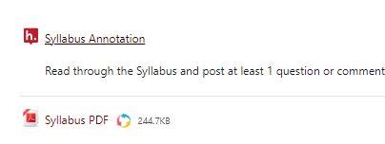
Syllabus Highlights
Course policies
Late Assignments
Grading
Collegiality
Schedule
Etc.

Slide 9
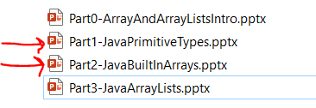
Plan for remainder of 1st hour
I lecture over BRIEFLY over these two slides
You read through them in more detail as needed (please ask questions during lecture or when reading)
Work time on practice problems for arrays

Slide 10
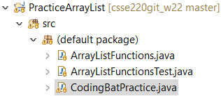



Array Practice Opportunity
Form groups of 2
Navigate to: http://codingbat.com/java/Array-2
Work in your groups to solve: fizArray3, bigDiff, shiftLeft
If you finish early, try: zeroFront
Save your codingbat work by copy and paste into CodingBatPractice.java

Slide 11
Work Time
Completing the Array Practice
Complete Daily Quiz
Looking at ArrayList Slides OR TwelveProblems
Notes:
As time allows:
1. See if anyone is asking about static, give simple explanation
2. Possible elaborate on an auto-boxing diagram

